Slide 1

Week # 15
Operations Research
(Software Engineering)

Slide 2
Network minimization
Network minimization deals with the determination of the branches that can join all the vertex/Nodes of a network, such that lengths of the chosen branches are minimized. This minimum Network is called a minimal spanning tree.

Slide 3
Procedure
Start from the node with minimum edge weight.
Exactly one path between two nodes. Cycle or loop not acceptable.
All vertices must be connected.
n vertices, (n-1) edges.
Connect smallest to highest values.

Slide 4
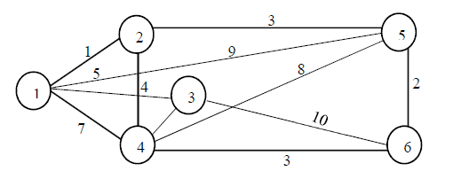
Minimal spanning tree Prim's algorithm (Greedy Algorithm)
6
5

Slide 5
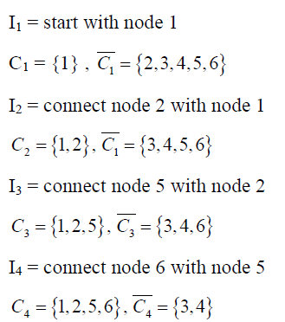
Minimal spanning tree

Slide 6


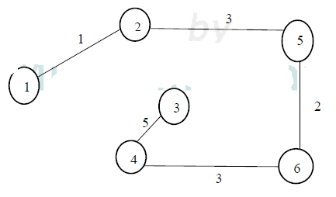
Minimal spanning tree

Slide 7
Minimal spanning tree
Minimum distance= 1+3+2+3+5 = 14

Slide 8
Minimal spanning tree
Midwest TV cable company is in process of providing cable service to five new housing development areas. The given figure depicts possible tv linkages among five areas. The cable miles are shown on each arc. Determine the most economical cable network.

Slide 9
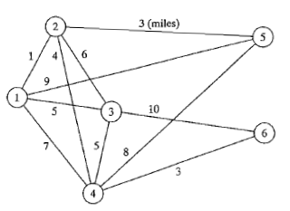
Minimal spanning tree

Slide 10
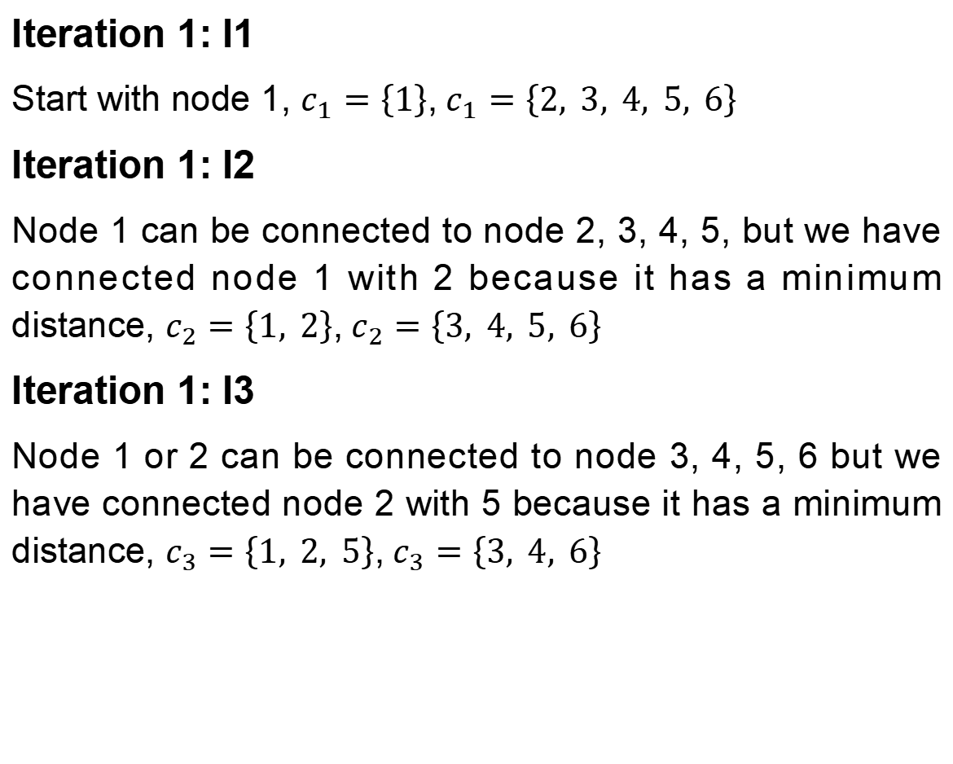
Minimal spanning tree
Iteration 1: I1
Start with node 1, $c_{1}=\left\{1\right\}$,${ c}_{1}=\left\{2, 3, 4, 5, 6\right\}$
Iteration 1: I2
Node 1 can be connected to node 2, 3, 4, 5, but we have connected node 1 with 2 because it has a minimum distance, $c_{2}=\left\{1, 2\right\}$,${ c}_{2}=\left\{3, 4, 5, 6\right\}$
Iteration 1: I3
Node 1 or 2 can be connected to node 3, 4, 5, 6 but we have connected node 2 with 5 because it has a minimum distance, $c_{3}=\left\{1, 2, 5\right\}$,${ c}_{3}=\left\{3, 4, 6\right\}$

Slide 11
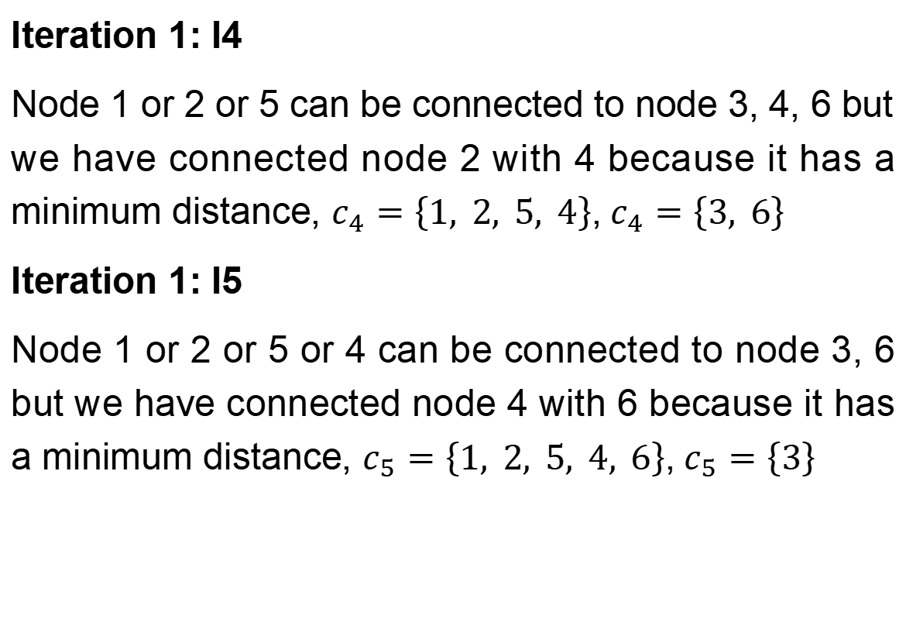
Minimal spanning tree
Iteration 1: I4
Node 1 or 2 or 5 can be connected to node 3, 4, 6 but we have connected node 2 with 4 because it has a minimum distance, $c_{4}=\left\{1, 2, 5, 4\right\}$,${ c}_{4}=\left\{3, 6\right\}$
Iteration 1: I5
Node 1 or 2 or 5 or 4 can be connected to node 3, 6 but we have connected node 4 with 6 because it has a minimum distance, $c_{5}=\left\{1, 2, 5, 4, 6\right\}$,${ c}_{5}=\left\{3\right\}$

Slide 12
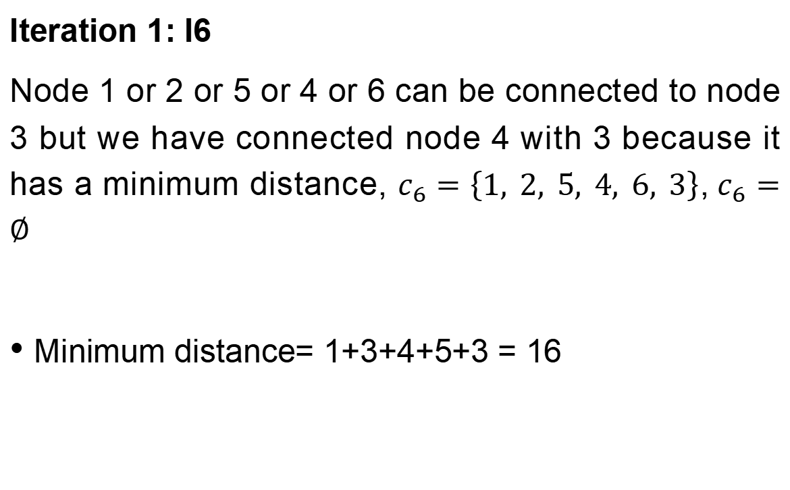
Minimal spanning tree
Iteration 1: I6
Node 1 or 2 or 5 or 4 or 6 can be connected to node 3 but we have connected node 4 with 3 because it has a minimum distance, $c_{6}=\left\{1, 2, 5, 4, 6, 3\right\}$,${ c}_{6}=∅$
Minimum distance= 1+3+4+5+3 = 16

Slide 13
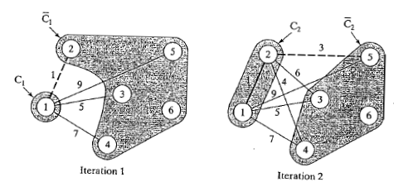
Minimal spanning tree

Slide 14
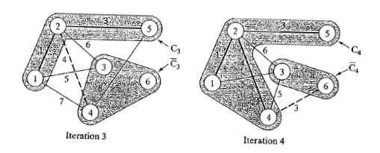
Minimal spanning tree

Slide 15
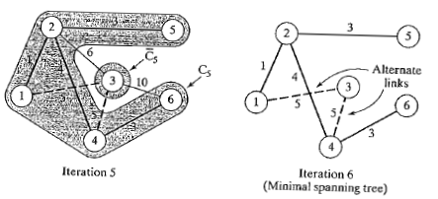
Minimal spanning tree

Slide 16
Minimal spanning tree
A company wants to connect 6 office branches (A, B, C, D, E, and F) using underground cables. The cost (in thousands of dollars) to connect each pair of offices is shown below. However not all offices are directly connected due to infrastructure limitations. Due to cost constraints, they want to use the least amount of cable possible to connect all branches without creating any loops.
Ans: 19 thousand dollars
Connection | Cost | Connection | Cost
A-B | 4 | C-F | 5
A-C | 3 | D-E | 6
B-C | 2 | D-F | 8
B-D | 7 | E-F | 3
C-D | 6

Slide 17
Thank you!

